Slide 1
CS 4032 – Web Programming
Dr. Hassan Sartaj

Slide 2
JavaScript
JavaScript to program the behavior of web pages

Slide 3
JavaScript - Introduction
JavaScript is client-side programming language
developed by Brendan Eich at Netscape
Communicates with web browser
Allows user-web page interactivity
JavaScript cannot be forced on users web browsers
Must be supported by web browsers
Most web browsers support JavaScript by default
JavaScript is not JAVA
JavaScript is an object-oriented language

Slide 4
What can JavaScript do?
JavaScript can dynamically modify an HTML page
JavaScript can react to user input
JavaScript can validate user input
JavaScript can be used to create cookies
JavaScript is a full-featured programming language
JavaScript user interaction does not require any communication with the server

Slide 5
How to include JavaScript in html
JavaScript programs require the <SCRIPT> tag in .html files
<script type = "text/javascript">
ACTUAL JavaScript code here
</script>
These can appear in either the <HEAD> or <BODY> section of an html document
Functions and code that may execute multiple times is typically placed in the <HEAD>
These are only interpreted when the relevant function or event-handler are called
Notes:
You can have any number of scripts • Scripts can be placed in the HEAD or in the BODY – In the HEAD, scripts are run before the page is displayed – In the BODY, scripts are run as the page is displayed • In the HEAD is the right place to define functions and variables that are used by scripts within the BODY

Slide 6
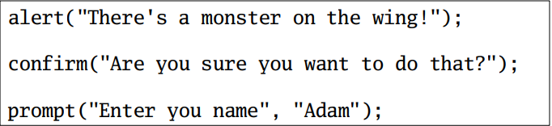
Simple User Interaction
There are three built-in methods of doing simple user interaction
– alert(msg) alerts the user that something has happened
– confirm(msg) asks the user to confirm (or cancel) something
– prompt(msg, default) asks the user to enter some text
– console.log(msg) — Writes information to the browser console, good for debugging purposes
– document.write(msg) — Write directly to the HTML document

Slide 7
Simple Example
<HTML>
<HEAD>
<TITLE>First JavaScript Example</TITLE>
</HEAD>
<BODY>
<H2>This line is straight HTML</H2>
<H3>
<SCRIPT type = "text/javascript">
document.write("These lines are produced by<br/>");
document.write("the JavaScript program<br/>");
alert("Hey, JavaScript is fun!");
</SCRIPT>
</H3>
<H2>More straight HTML</H2>
</BODY>
</HTML>

Slide 8
JavaScript - Variables
JavaScript variables have no types
Type is determined dynamically, based on the value stored
This is becoming familiar!
The typeof operator can be used to check type of a variable
Declarations are made using the var or let keyword
Can be implicitly declared, but not advisable
Declarations outside of any function are global
Declarations within a function are local to that function
Variables declared but not initialized have the value undefined
Variable identifiers are like those in other languages (ex: Java)
Cannot use a keyword
Must begin with a letter, $, or _
Followed by any sequence of letters, $, _ or digits
Case sensitive

Slide 9
JavaScript Expressions
Numeric operators in JavaScript are similar to those in most languages
+, –, *, /, %, ++, --
Precedence and associativity are also fairly standard
Strings
Have the + operator for concatenation
Have a number of methods to do typical string operations
charAt, indexOf, toLowerCase, substring
Looks kind of like Java – intentionally

Slide 10
JavaScript Control Statements
JavaScript has most of the operators that we used in C++/Java
– Arithmetic (+, - , * , /, %)
– Assignment (= , += , -= , *= , /= , %= , ++, --)
– Logical (&&, ||, !)
– Comparison (<, >, <= , >= , ==)
Constructs:
if, else, switch, case
while, do-while, for, for-in, for-each

Slide 11
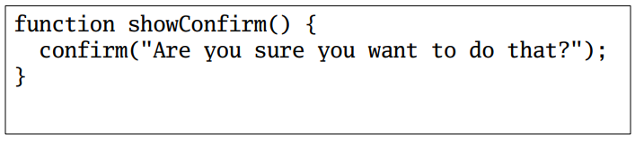
JavaScript Functions
JavaScript lets you define functions using the function keyword
Functions can return values using the return keyword

Slide 12
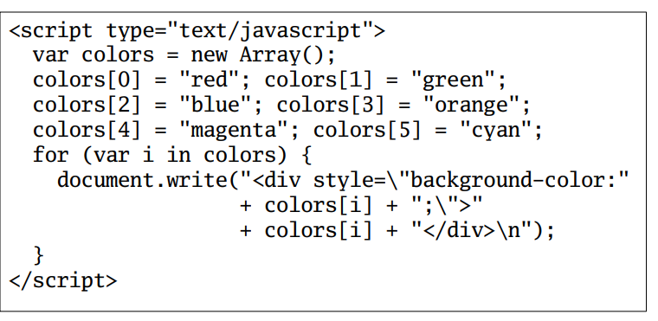
JavaScript Arrays
JavaScript has arrays that are indexed starting at 0
Special version of for works with arrays

Slide 13
JavaScript Events
JavaScript can be made to respond to user events
Common Events:
– onload and onunload : when a page is first visited or left
– onfocus, onblur, onchange : events pertaining to form elements
– onsubmit : when a form is submitted
– onmouseover, onmouseout : for "menu effects"

Slide 14
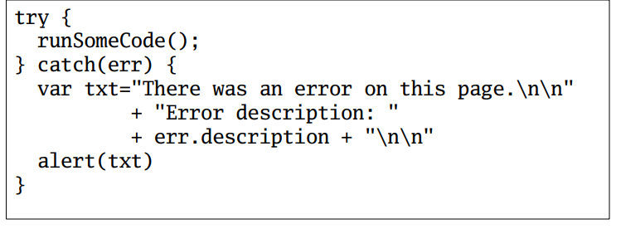
Exception Handling
JavaScript also has try, catch, and throw keywords for handling JavaScript errors.

Slide 15
Comments in JavaScript
Comments in JavaScript are delimited with // and /* */ as in Java and C++

Slide 16
JavaScript Objects
Some basic objects are built-in to JavaScript
– String – Date – Array – Boolean – Math

Slide 17
JavaScript Objects
Objects are certain kinds of variables
They are variables that can have their own values and methods
var person = {
firstName:"John",
lastName:"Doe",
age:20,
nationality:"German"
};

Slide 18
JavaScript Strings
A String object is created every time you use a string literal (just like in Java)
Have many of the same methods as in Java
– charAt, concat, indexOf, lastIndexOf, match, replace, search, slice, split, substr, substring, toLowerCase, toUpperCase, valueOf
• There are also some HTML specific methods
– big, blink, bold, fixed, fontcolor, fontsize, italics, link, small, strike, sub, sup
• Don't use the HTML methods (use CSS instead)
– This is the worst kind of visual formatting

Slide 19
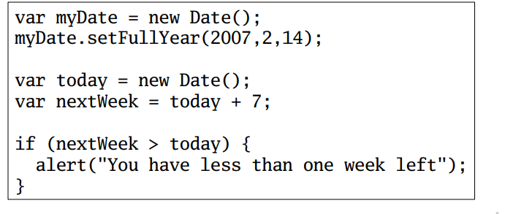
JavaScript Dates
The Date class makes working with dates easier
A new date is initialized with the current date
Dates can be compared and incremented

Slide 20
JavaScript and the DOM
Using DOM, JavaScript can perform multiple tasks
create new elements and attributes
change the existing elements and attributes
remove existing elements and attributes
JavaScript can also react to existing events and create new events in the page
Notes:
web browser creates a DOM of the webpage when the page is loaded.

Slide 21
HTML DOM: Document
The Document object represents an HTML document and can be used to access all documents in a page
A Document contains several collections
– anchors, forms, images, links
Has several properties
–name, id, title, URL, ref, etc.

Slide 22
HTML DOM: Objects
Environment objects
– Window, Navigator, Screen, History, Location, Document
HTML objects
– Anchor, Area, Base, Body, Button, Event, Form, Frame, Frameset, Iframe, Image, Checkbox, FileUpload, Hidden, Password, Radio, Reset, Submit, Text, Link, Meta, Object, Option, Select, Style, Table, TableCell, TableRow, TextArea

Slide 23

HTML DOM: The Document Tree
Notes:
Accessing elements and changing their properties lets us do simple things like form validation, data transfer etc •
HTML DOM lets us do much more
• We can create, delete, and modify parts of the HTML document • For this we need to understand the Document Tree

Slide 24
Dynamic HTML (DHTML)
Manipulating the web page's structure is essential for creating a highly responsive UI
Dynamic HTML content modification
Two main approaches
Manipulate page via plain JS
Manipulate page using JS + library (e.g., jQuery)

Slide 25
Navigating the Document Tree
With JavaScript we can navigate the document tree
document.getElementById()
document.getElementsByName()
document.getElementsByTagName() return nodes in the document tree
document.innerHTML: To access the content of an element
document.createElement: To create new element
document.createAttribute: To create new attribute
document.removeChild: Remove an element
Document.appendChild: Appends an element
• Information can be obtained from
nodeName – The tag name
nodeValue – The text of a text node
nodeType – The kind of node

Slide 26

Rewriting using innerHTML attribute
<span id="stuff"></span>
<form><input id="inpt" onchange="doit()"></form>
<script>
function doit() {
document.getElementById("stuff").innerHTML =
document.getElementById("inpt").value;
}
</script>
Rewriting the contents of a span. NOTE: There is a security problem in the code above.
Notes:
Unlike innerText, though, innerHTML lets you work with HTML rich text and doesn't automatically encode and decode text. In other words, innerText retrieves and sets the content of the tag as plain text, whereas innerHTML retrieves and sets the same content but in HTML format.
<!DOCTYPE html>
<html>
<head>
<title>
Difference between
InnerHTML and InnerText
</title>
</head>
<body style="text-align:center;">
<h1 style="color:green">GeeksforGeeks</h1>
<div id="test">
The following element contains some
<codes>code</codes> and
<italic>some text</italic>.
</div>
<p></p>
<button onClick="innerTextFn()">
innerHTML
</button>
<button onClick="innerHTMLFn()">
innerText
</button>
<p id="op"></p>
<script>
function innerTextFn() {
var x = document.getElementById('test');
alert(x.innerText);
}
function innerHTMLFn() {
var x = document.getElementById('test');
alert(x.innerHTML);
}
</script>
</body>
</html>

Slide 27

Assigning the .innerText instead
<span id="stuff"></span>
<form><input id="inpt" onchange="doit()"></form>
<script>
function doit() {
document.getElementById("stuff").innerText =
document.getElementById("inpt").value;
}
</script>
Rewriting the contents of a span. NOTE: There is a browser-compatibility problem in the code above.
Notes:
Some old browsers do not support innerText

Slide 28
Example
<html>
<head>
<title>DOM!!!</title>
</head>
<body>
<h1 id="one">Welcome</h1>
<p>This is the welcome message.</p>
<h2>Technology</h2>
<p>This is the technology section.</p>
<script type="text/javascript">
var text = document.getElementById("one").innerHTML;
alert("The first heading is " + text);
</script>
</body>
</html>

Slide 29
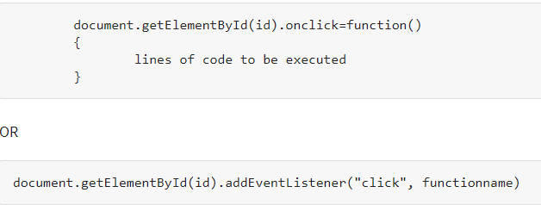
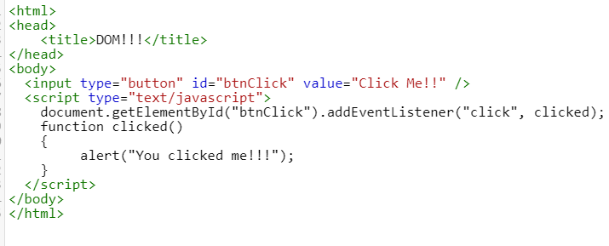
Event handler
You can add an event handler to a particular element like this

Slide 30
JSON: JavaScript Object Notation
Defines a format to store information in an organized and easy-to-access way
Douglas Crockford specified the JSON format in the early 2000s.
The official website was launched in 2002.
JSON became an ECMA international standard in 2013.
The most updated JSON format standard was published in 2017.
Notes:
If you are building a full stack application, with a front end that interacts with an API and communicates with a server, then JSON is the standard language to use for sending and receiving data using your standard HTTP requests.
Since there is no better or equivalent alternative, you sort of will have to use it if you are going to be developing on the web or mobile.

Slide 31
JSON Data Types
String
E.g., { "name":"John" }
Number
E.g., {"age": 25}
Object (JSON object)
E.g., { "employee":{ "name":"John", "age":30, "city":"New York" } }
Array
E.g., { "employees":[ "John", "Anna", "Peter" ] }
Boolean
E.g., { “active”:true }
Null
E.g., {"middlename":null}

Slide 32
Parsing JSON
The data received from server is always in the form of a string
Parse the data with JSON.parse()
Returns a JavaScript object
E.g.,
var obj = JSON.parse('{ "name":"John", "age":30, "city":"New York"}’);
obj.name, obj.age, obj.city
If the server response is a JavaScript array
JSON.parse() will return an array

Slide 33
How to convert JavaScript object to JSON text?
By using method JSON.stringify()
Converts JavaScript object to string
var obj = { name: "John", age: 30, city: "New York" };
var jsonText= JSON.stringify(obj);
It is also possible to stringify JavaScript arrays

Slide 34
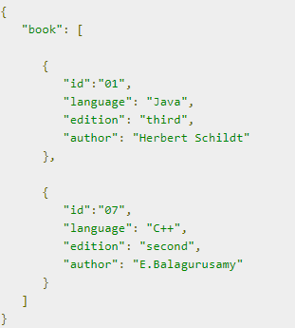
Simple Example in JSON
The following example shows how to use JSON to store information related to books based on their topic and edition.
It basically has key-value pairs.
var Book= {
“id" : “01",
“language" : “Java",
“edition" : “third",
“author" : “Herbert Schildt"
};
document.writeln("The Language is: " + Book.language);
document.writeln("its Edition is: " + Book.edition);
document.writeln("its Author is: "+ Book.author;
var myJSObject = JSON.parse(Book);

Slide 35
AJAX
AJAX - Asynchronous JavaScript and XML
AJAX is not a programming language
AJAX is a way of using existing standards (JavaScript and XML) to make more interactive web applications
AJAX was popularized in 2005 by Google (with Google suggest)
Can be used to update page content without refreshing the page
Pages update asynchronously
Google Maps, Gmail

Slide 36
AJAX Technologies
AJAX is based on web development technologies
JavaScript: The programming language used to develop Ajax applications
XML: Provides a means of exchanging structured data between the web server and client
The XMLHttpRequest object: Provides the ability to asynchronously exchange data between web browsers and a web server
HTML and CSS: Provides the ability to mark up and style the display of web page text
The DOM: Provides the ability to dynamically interact with and alter the web page layout and content

Slide 37
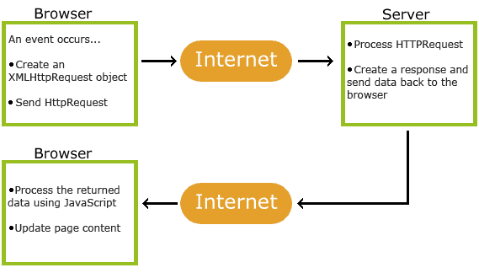
How AJAX Works
Notes:
1. An event occurs in a web page (the page is loaded, a button is clicked)
2. An XMLHttpRequest object is created by JavaScript
3. The XMLHttpRequest object sends a request to a web server
4. The server processes the request
5. The server sends a response back to the web page
6. The response is read by JavaScript
7. Proper action (like page update) is performed by JavaScript

Slide 38
AJAX - The XMLHttpRequest Object
The XMLHttpRequest object can be used to exchange data with a server
Syntax for creating an XMLHttpRequest object:
variable = new XMLHttpRequest();
Old Versions of Internet Explorer (IE5 and IE6)
Use an ActiveX object instead of the XMLHttpRequest object:
variable = new ActiveXObject("Microsoft.XMLHTTP");

Slide 39
AJAX - Send a Request
Method | Description
open(method, url, async) | Specifies the type of request method: the type of request: GET or POST url: the server (file) location async: true (asynchronous) or false (synchronous)
send() | Sends the request to the server (used for GET)
send(string) | Sends the request to the server (used for POST)

Slide 40
AJAX - Server Response
Property | Description
onreadystatechange | Defines a function to be called when the readyState property changes
readyState | Holds the status of the XMLHttpRequest. 0: request not initialized 1: server connection established 2: request received 3: processing request 4: request finished and response is ready
status | 200: "OK" 403: "Forbidden" 404: "Page not found"
statusText | Returns the status-text (e.g. "OK" or "Not Found")
responseText | Get the response data as a string
responseXML | Get the response data as XML data

Slide 41


A very simple web page and XML
<!DOCTYPE html><html><head>
<script src="jquery-1.8.2.min.js"></script>
</head><body>
<div id="clickme" onclick="startAjax()">Click me</div>
<script>
function startAjax() {
$("#clickme").text("Calling server");
$.ajax({url:"somefile.xml",
success:callbackFunction, error:errorFunction}
);
}
function callbackFunction(data,info) {
$("#clickme").text("result:"+data);
}
function errorFunction(data,info) {
$("#clickme").text("error occurred:"+info);
}
</script>
</body></html>
somefile.xml
<?xml version="1.0"?>
<root>
<entry name="blah">ok</entry>
</root>

Slide 42
Thank you!

